Slide 1

Climbing Club Meeting 02/27/2024

Slide 2
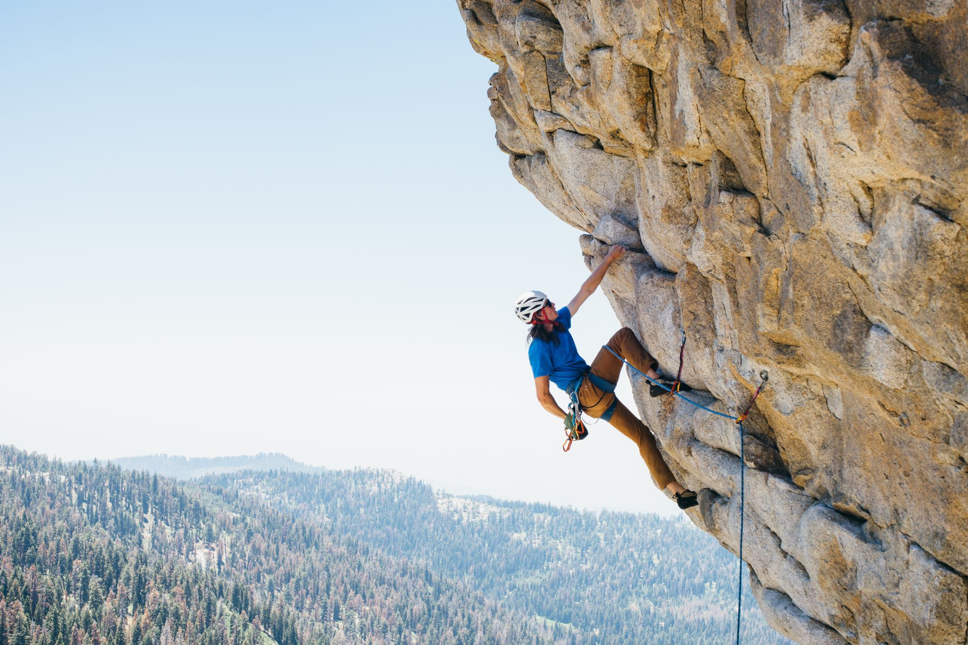
Plans for the Semester
Continued Climbing Gym Use
Beach Clean-Up With Environmental Club
Some Outdoors trips
Powerlinez
Gunks

Slide 3
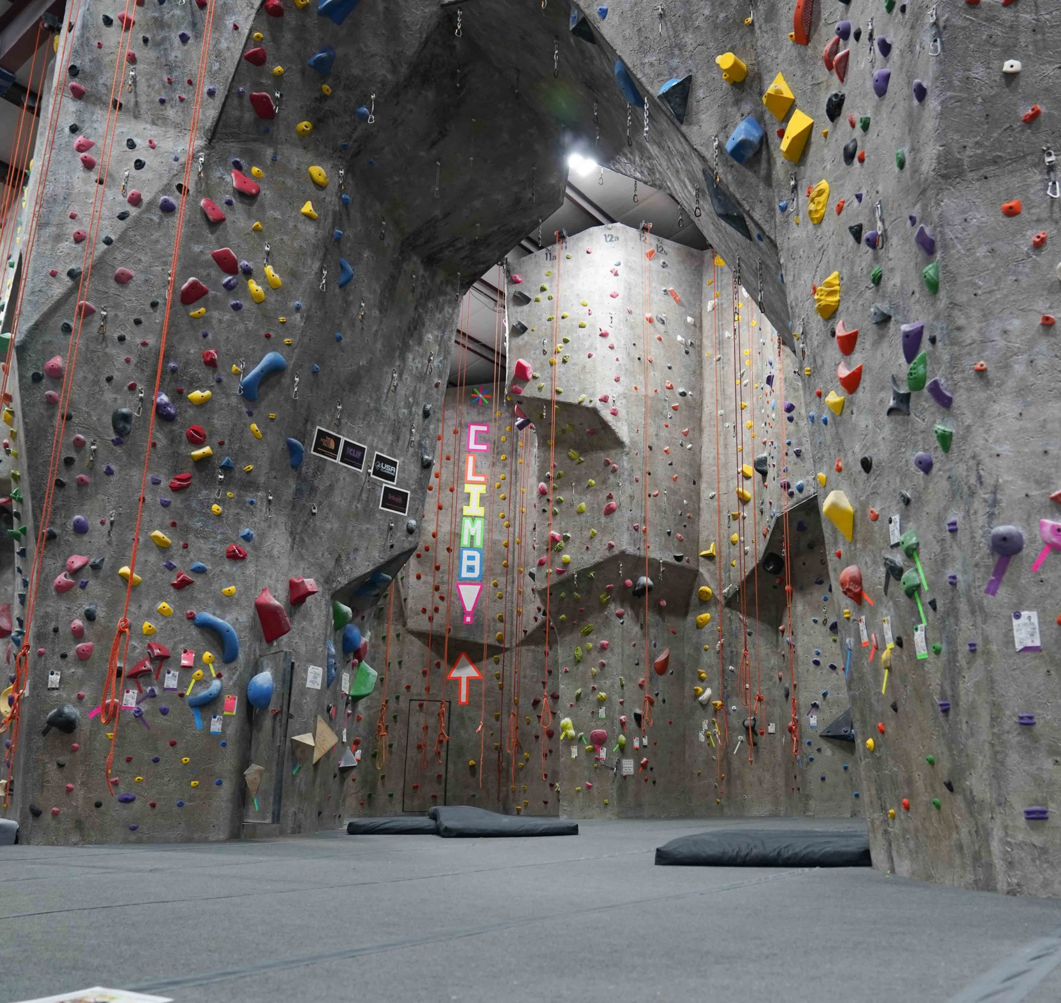
THE ROCK CLUB (Local Climbing Gym)
Facility In New Rochelle
Facility Open to all Club Members
Bouldering
Top Rope
Belaying
Lead Climbing
Slackline
Loft/Study area
Climbing Classes

Slide 4
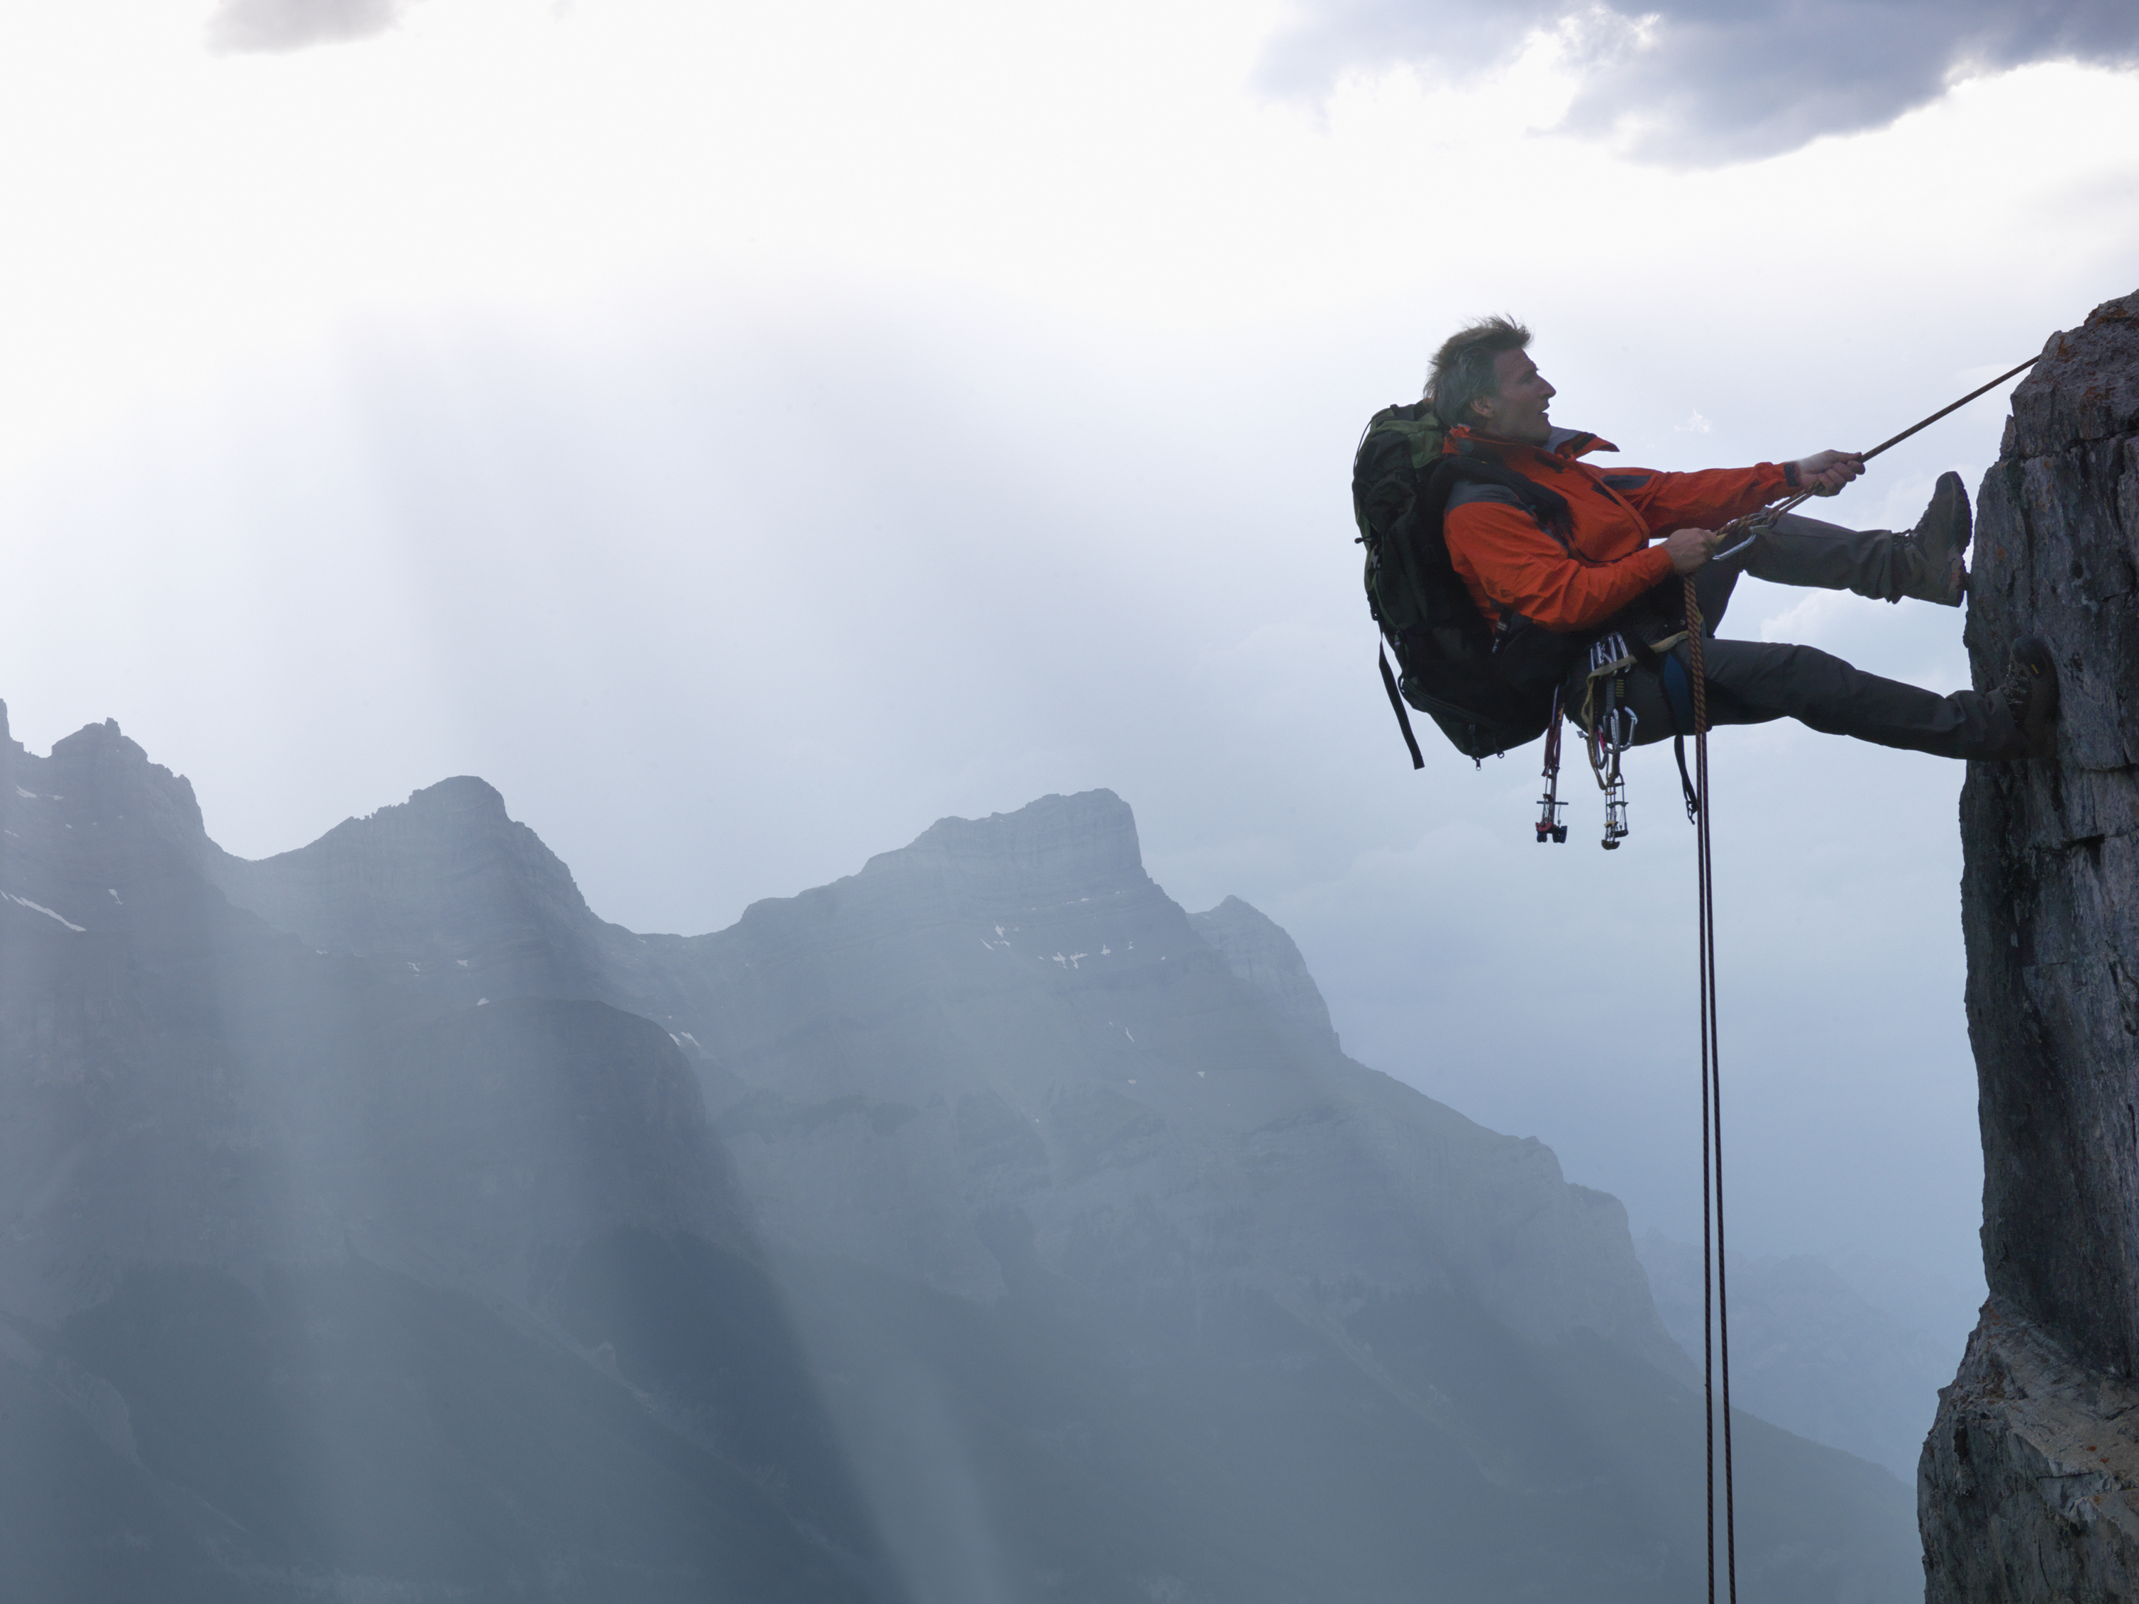
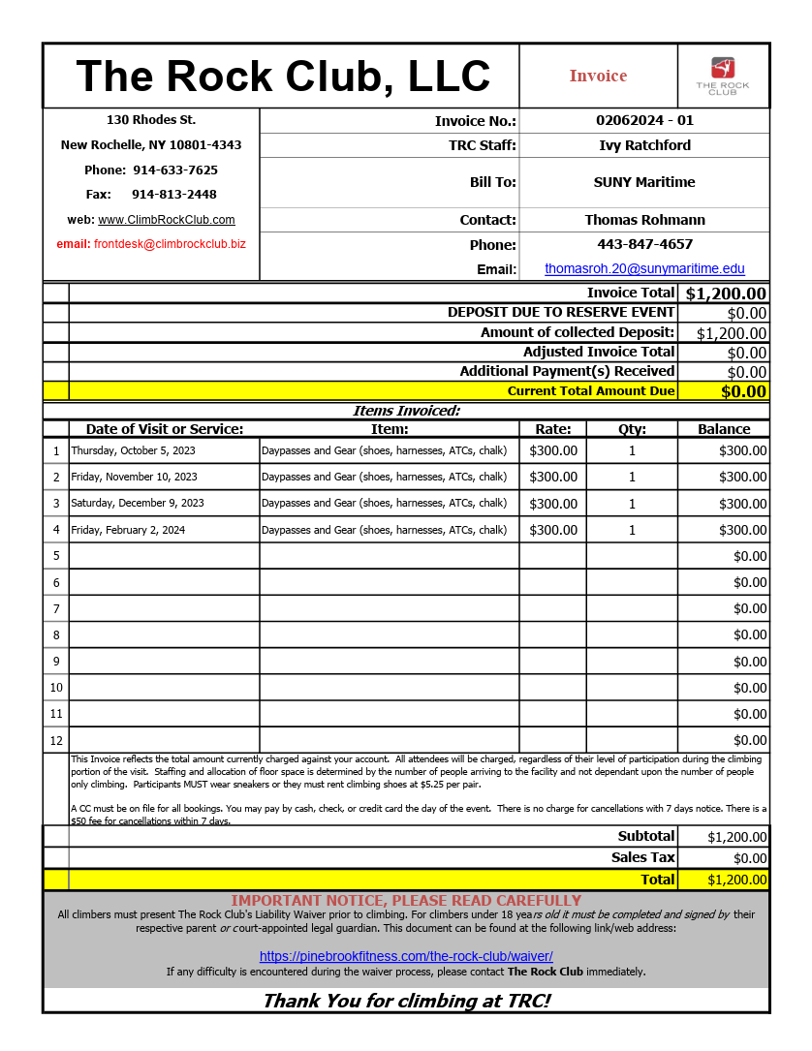
How much does it cost to do this?
$1,200 Spent last semester for gym access

Slide 5
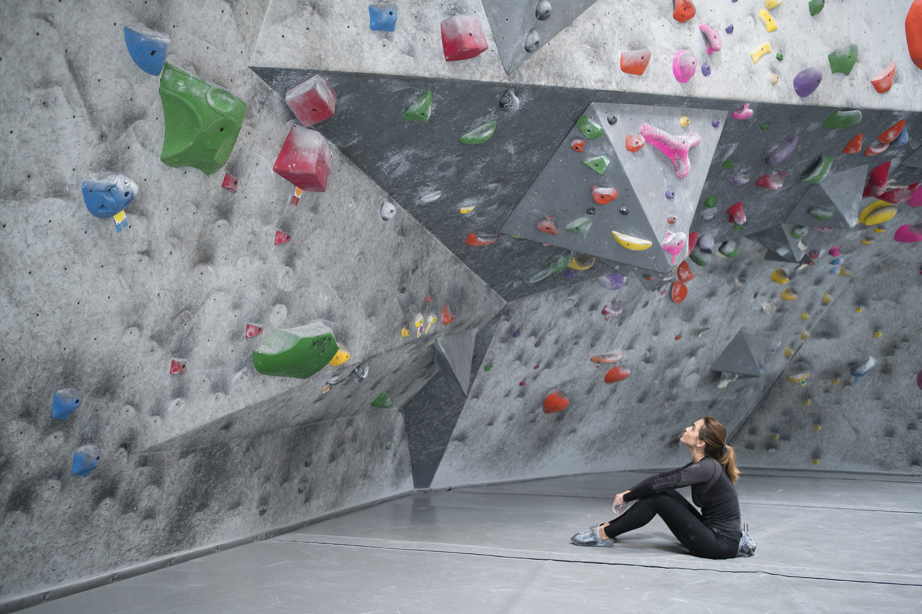
How We Raised Funds
$500 from Parents Association Last semester
In the process of applying for Parents association funding and FSA Funding for this semester
Internal fundraising ($36 buy in to use club money at climbing gym)
Presenting to SGA, asking $2,500

Slide 6
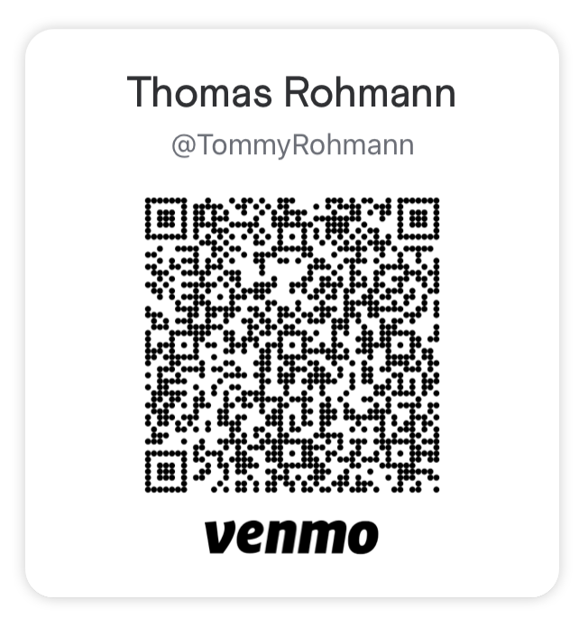
How to Buy Into Using the Gym
You can pay $36 Cash to Tommy Rohmann, or Venmo me at

Slide 7
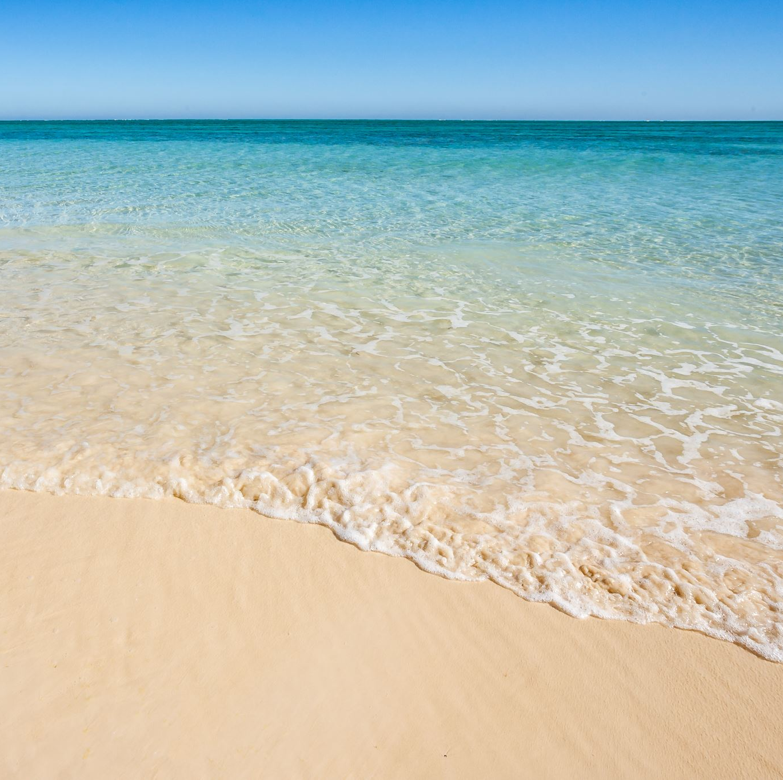
Beach Clean-Up
Time and date tbd, but important that we do as a club

Slide 8
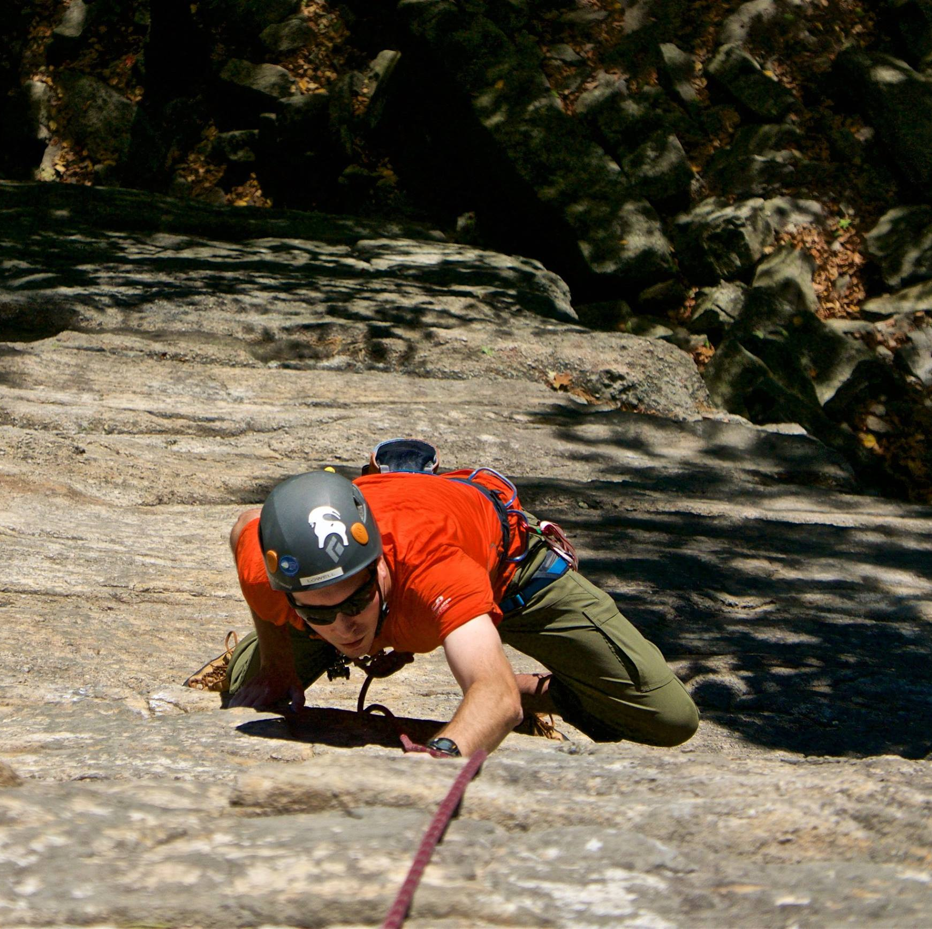
Outdoors Trips
In the club, we do not have the the knowledge to outdoor climbing, but we hope to do climbing lessons in the Gunks or at the Powerlinez so that next year, we can just go on a free weekend.

Slide 9
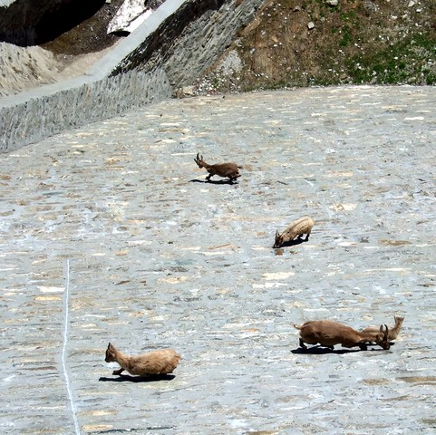
That’s all
Thanks
Thomasroh.20@sunymaritime.edu
This Photo by Unknown author is licensed under CC BY-SA-NC.

Slide 10
Sike
You thought

